Slide 1
faculty: b. k. dhar assistant professor faculty of business administration, ustc e-mail: babludhar@hotmail.com web: http://dhar.weebly.com
MBA Program
Conflict & Crisis Management

Slide 2
Chapter 1 INTRODUCTION
Conflict & Crisis Management
Notes:
This presentation demonstrates the new capabilities of PowerPoint and it is best viewed in Slide Show. These slides are designed to give you great ideas for the presentations you’ll create in PowerPoint 2010!
For more sample templates, click the File tab, and then on the New tab, click Sample Templates.

Slide 3
Introduction
1
2
3
4
Expectations
General skills
Communication
Techniques
Conflict & Crisis Management

Slide 4
Expectations as the root of all conflict and crisis
1
Conflict & Crisis Management

Slide 5
LET’S WATCH A VIDEO
Conflict & Crisis Management

Slide 6
Conflict & Crisis Management

Slide 7
Conflict & Crisis Management

Slide 8
General skills required for dealing with conflict and complaints
2
Conflict & Crisis Management

Slide 9
Conflict & Crisis Management

Slide 10
Conflict & Crisis Management

Slide 11
Communication styles as barriers to dealing with conflicts and complaints
3
Conflict & Crisis Management

Slide 12
Conflict & Crisis Management

Slide 13
Techniques for dealing with conflict and complaints
4
Conflict & Crisis Management

Slide 14
LET’S ENJOY A VIDEO
Conflict and Crisis Management

Slide 15
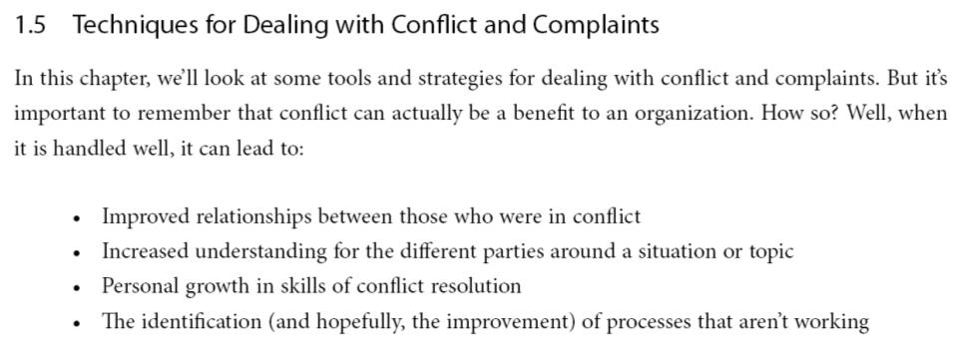
Conflict & Crisis Management

Slide 16
Conflict & Crisis Management

Slide 17
This is the END
of the Chapter
Thank You

